Slide 1

Chapter 4
Strings

Slide 2
Content
What is a string
Function len
Characters
Loop over a string
Slicing
Compare strings
String methods

Slide 3
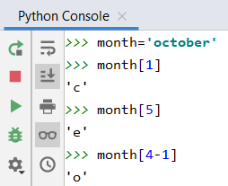
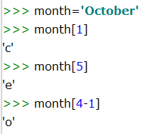
String
A string is a composite data type: consists of an ordered sequence of characters
The characters of the string can be reached via the index, which starts counting from 0.
Example:
month = 'October' or
month = "October"
month[2]
A string is ‘immutable’. This means: never write month[2]='p'
O | c | t | o | b | e | r
0 | 1 | 2 | 3 | 4 | 5 | 6

Slide 4
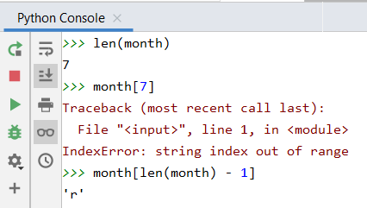
Length of a string
Built-in function len()
You pass the string as an argument: e.g. len(month)
The result indicates how many characters the string consists of
Note: a string with length 7 has 7 characters which are numbered 0 ... 6
O | c | t | o | b | e | r
0 | 1 | 2 | 3 | 4 | 5 | 6

Slide 5
Characters
Strings are an ordered sequence of characters
Each character is represented internally in binary form
Standardized character sets:
ANSI (American National Standards Institute)
ASCII (American Standard Code for Information Interchange)
Uses bytes
ASCII table links bytes to symbols
2 ⁷ | 2 ⁶ | 2 ⁵ | 2 ⁴ | 2 ³ | 2 ² | 2 ¹ | 2 ⁰
0 | 1 | 0 | 0 | 1 | 1 | 0 | 0
128 | 64 | 32 | 15 | 8 | 4 | 2 | 1
L

Slide 6
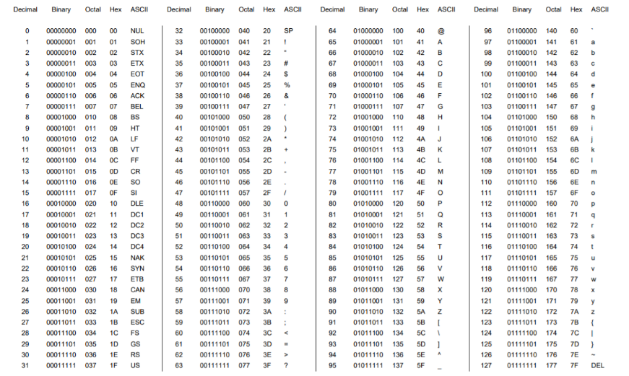
Characters: ASCII table
https://www.eecis.udel.edu/~amer/CISC651/ASCII-Conversion-Chart.pdf

Slide 7
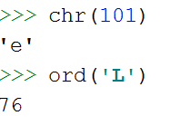
Characters
Built-in functions
ord() character to ASCII code (integer)
chr() ASCII code (integer) to character
Example 1: print every letter of the alphabet
start = ord('a') for i in range(26): print(chr(start + i) + ' ', end='')

Slide 8
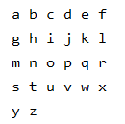
Characters
Example 2: printing all letters of the alphabet 6 by 6
i%6 You calculate the rest by dividing by 6 and that is 0, 1, 2, 3, 4 or 5. As soon as the rest = 5, you go to a new line using print()
start = ord('a') for i in range(26): print(chr(start + i) + ' ', end='') if i % 6 == 5: print()

Slide 9
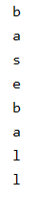
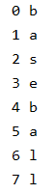
Loop over the characters of a string
Example 1: while
Example 2: for loop with range
Example 3: for loop
sport = "baseball" i = 0 while i < len(sport): print(sport[i]) i += 1
sport = "baseball" for letter in sport: print(letter)
sport = "baseball" for i in range(len(sport)): print(i, sport[i])

Slide 10
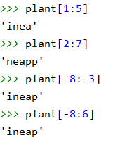
Slicing
When you need a part of a string, you use slicing.
name_string[start:end] (note: character at the end is NOT included)
Example:
plant = 'pineapple'
0 | 1 | 2 | 3 | 4 | 5 | 6 | 7 | 8
p | i | n | e | a | p | p | l | e
-9 | -8 | -7 | -6 | -5 | -4 | -3 | -2 | -1

Slide 11
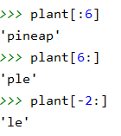
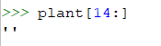
Slicing
name_string[start:end]
from the beginning of the string if start is empty
until the end of the string when end is empty
Note: you will not get an error if you go beyond the limits of the string:
0 | 1 | 2 | 3 | 4 | 5 | 6 | 7 | 8
p | i | n | e | a | p | p | l | e
-9 | -8 | -7 | -6 | -5 | -4 | -3 | -2 | -1

Slide 12
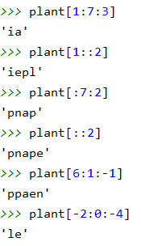
Slicing
Slicing operator can also be done with 3 parameters:
name_string[start:end:jump_size]
0 | 1 | 2 | 3 | 4 | 5 | 6 | 7 | 8
p | i | n | e | a | p | p | l | e
-9 | -8 | -7 | -6 | -5 | -4 | -3 | -2 | -1

Slide 13
Quiz
word = 'mystery'
word[2] s
word[2:] stery
word[:2] my
word[2:2] s
word[::2] msey
word[-2] r
word[-2:] ry
word[:-2] myste
word[::-2] /
word[-2::-2] /
word[::-1] /

Slide 14
Quiz: solutions
word = 'mystery'
word[2]
word[2:]
word[:2]
word[2:2]
word[::2]
word[-2]
word[-2:]
word[:-2]
word[::-2]
word[-2::-2]
word[::-1]
's'
'stery'
'my'
''
'msey'
'r'
'ry'
'myste'
'yesm'
'rty'
'yretsym'

Slide 15
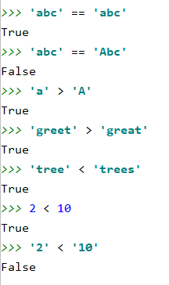
Compare strings
Strings are compared character by character according to the ASCII table
Examples:
The number 2 is smaller than the number 10
If we compare them as strings, the character '2' is 'bigger' than the character '1'

Slide 16
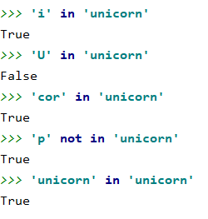
Compare strings: operator (not) in
The operator in checks whether the first string is part of the second string
Examples:
A string is a substring of itself

Slide 17
Strings: program example
Turn a sentence with punctuation marks into a sentence without punctuation marks
punctuation_marks = ',.:;?!' sentence = input('Enter a sentence with punctuation marks: ') sentence_without = '' for letter in sentence: if letter not in punctuation_marks: sentence_without += letter print('The sentence without punctuation marks:', sentence_without)

Slide 18
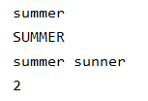
Stringmethoden
Method = function linked to a certain object
Notation: name_object.name_method(parameters)
String methods return a new string, the original string remains unchanged
season = "summer" season.capitalize() print(season) print(season.upper())
new_season = season.replace('m','n') print(season, new_season) print(season.count('m'))

Slide 19
String methods
name | functionality | example | result
capitalize | convert first letter to uppercase letter | "python".capitalize() | Python
lower | convert all letters to lowercase | 'IT Factory'.lower() | it factory
upper | convert all letters to uppercase | 'IT Factory'.upper() | IT FACTORY
strip | remove leading and trailing whitespace (spaces, tabs, line breaks, ...) | ' a b '.strip() | 'a b'
lstrip | remove leading whitespace | ' a b '.lstrip() | 'a b '
rstrip | remove trailing whitespace | ' a b '.rstrip() | ' a b'
count | count how often one string occurs within another string | "cucumber".count("cu") | 2
find | look up the position where a string occurs for the first time within another string (-1 if no occurrences found) | 'python'.find('ho') 'python'.find('is') | 3 -1
replace | replace all occurrences of one string with another string | 'python'.replace('yth','o') | 'poon'

Slide 20
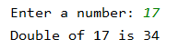
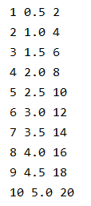
String methods: format
Format is a string method that takes care of the formatting of the text
number = int(input('Enter a number: ')) print('Double of {} is {}'.format(number, number * 2))
for number in range(1,11): print('{} {} {}'.format(number, number / 2, number * 2))

Slide 21
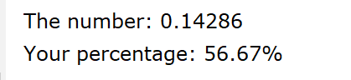
String methods: format
Float formatting:
An overview of the possibilities can be found at: https://docs.python.org/3/library/string.html#formatstrings.
number = 1 / 7 score = 17 print('The number: {:.5}'.format(number)) print('Your percentage: {:.2%}'.format(score / 30))

Slide 22
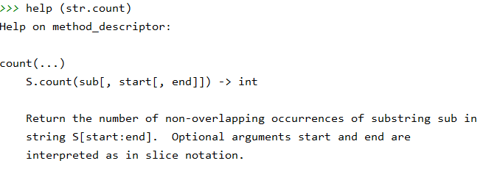
String methods
Where can you find information about a string method?
For an overview:
https://docs.python.org/3/library/stdtypes.html#string-methods

